Slide 1
KIDS LEARNING GAME

Slide 2
INTRODUCTION:-
This project is about IMAGE RECOGNITION .
In this game the kids will watch the various images for some particular time and after that they have to recognize them by the names of images.

Slide 3
Concepts used in project:-
Standard Attributes :-
Colors
Anchors
Geometry management:-
Pack() method
Grid() method
Tkinter widgets :
Canvas
Button
Check button
Top level
tkMessageBox

Slide 4
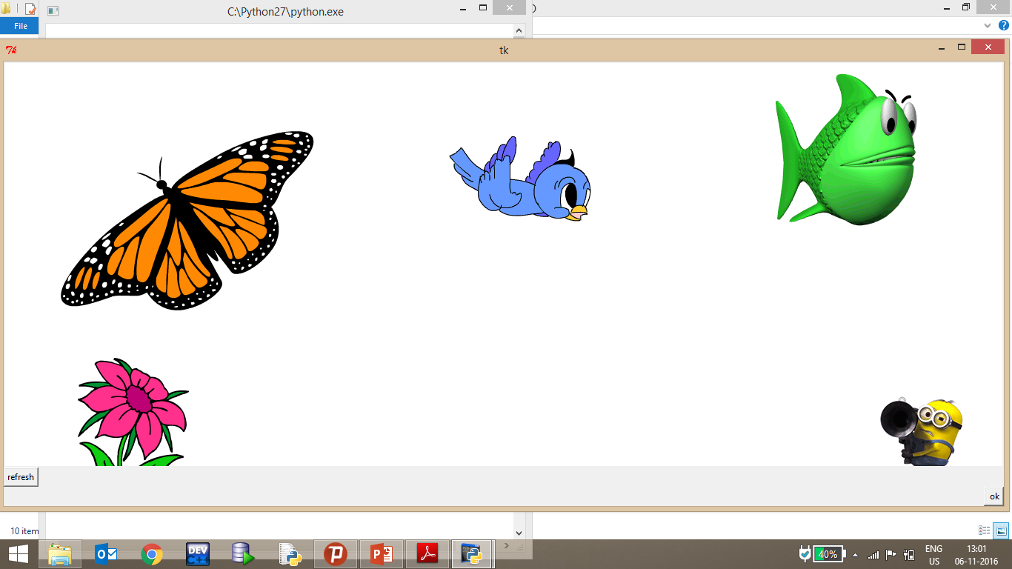
Description About Project:
Step 1:-
This is the first
interface of the Game.
This shows Some pictures
to the kid and the kid
Should remember
The names of images.

Slide 6
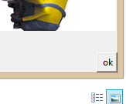
Step 2:-
After seeing the images there will be a “ OK “ button at the last of the page as shown in the picture.

Slide 7
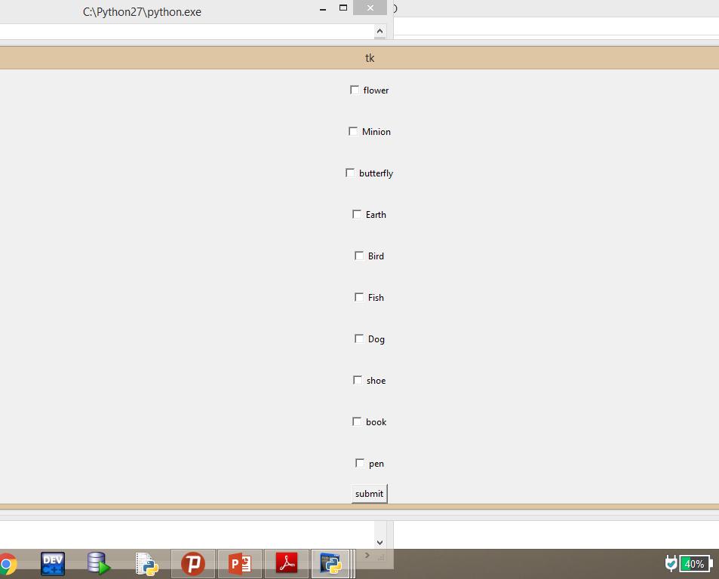
Step 3:-
After pressing the
“ OK “ button, the interface shown in the picture will be displayed,In which the options are available to select as shown in picture.

Slide 8

Step 4:-
Mark the options that which you remember.

Slide 9
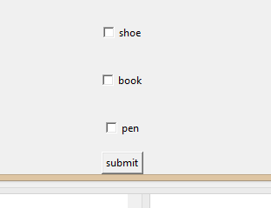
Step 5:-
After selecting the options click on the “submit” button which is at the end of the page.

Slide 10
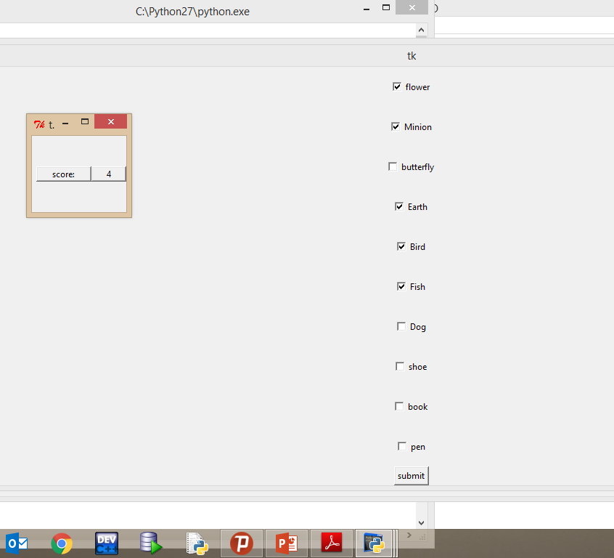
Step 6:-
Displays the score of the player.

Slide 11
Flow CHART:-
START
REFRESH
OK
SUBMIT
SCORE

Slide 12
Thank you
Submitted To:-
Mr. Prateek Agrawal
Submitted by:-
1).RK1501 B47
2).RK1501 B37
3).RK1501 B28

